Slide 1
Animals

Slide 2
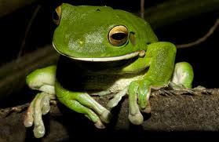
First animal: frog

Slide 3
Frogs eat flies, spiders, and other insects.
Frogs can live anywhere in the world (except Antarctica).
Frogs move by pushing their legs against the ground, and jumping.

Slide 4
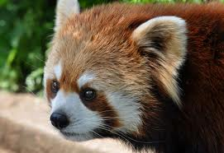
Second animal: red panda.

Slide 5
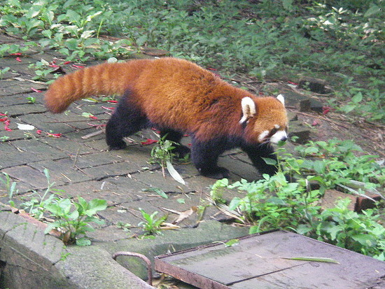
Red pandas eat berries, eggs, blossoms, and bamboo.
Red pandas live in China, Myanmar, and Burma.
Red pandas move by climbing through trees with their claws and tail.

Slide 6
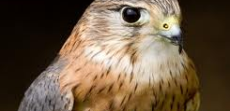
Third animal: merlin falcon.

Slide 7
The merlin falcon eats rodents, like mice and rats, and also eats smaller birds.
Merlin falcons live in most of North America. I know, because I’ve seen one.
Merlin falcons move by flapping their wings, and flying.

